Slide 1
ATLIQ HOSPITALITY-ANALYSIS

Slide 2
INTRODUCTION
Atliq Grands owns multiple five-star hotels across India. They have been in the hospitality industry for the past 20 years. Due to strategic moves from other competitors and ineffective decision-making in management, Atliq Grands are losing its market share and revenue in the luxury/business hotels category.

Slide 3
PROBLEM STATEMENT
As a strategic move, the managing director of Atliq Grands wanted to incorporate “Business and Data Intelligence” in order to regain their market share and revenue.
However, they do not have an in-house data analytics team to provide them with these insights. Their revenue management team had decided to hire a 3rd party service provider to provide them with insights from their historical data.

Slide 4
Dataset
Category
City
Property_id
Property_name
Date Type Hotels Bookings Aggregated Bookings Room Type
Capacity
checkIn date
Month name
Property_id
Room_category
Successful booking
Total Bookings
Date
Month name
Booking Date
Week no
Day type
Booking Id
Booking Platform
Booking Platform
Booking status
City
Property_id
Property_name
Checkin date
Checkout date
Ratings given
Revenue generated
Revenue realised
Room_category
Room_class
Room_id

Slide 5
DATA ANALYSIS PROCESS
Problem Statement
Data Collection
Data Cleaning
Analysing the Data
Data Visualisation
Data Presentation

Slide 6
Main KPI’s
Average Ratings Given
Total revenue by Properties
Total Bookings by Properties
Booking rate
Occupancy rate
Revenue by month, week no, Day type, room_class, Booking platform, Booking status.
Booking by month, week no, Day type, room_class, Booking platform, Booking status.

Slide 7
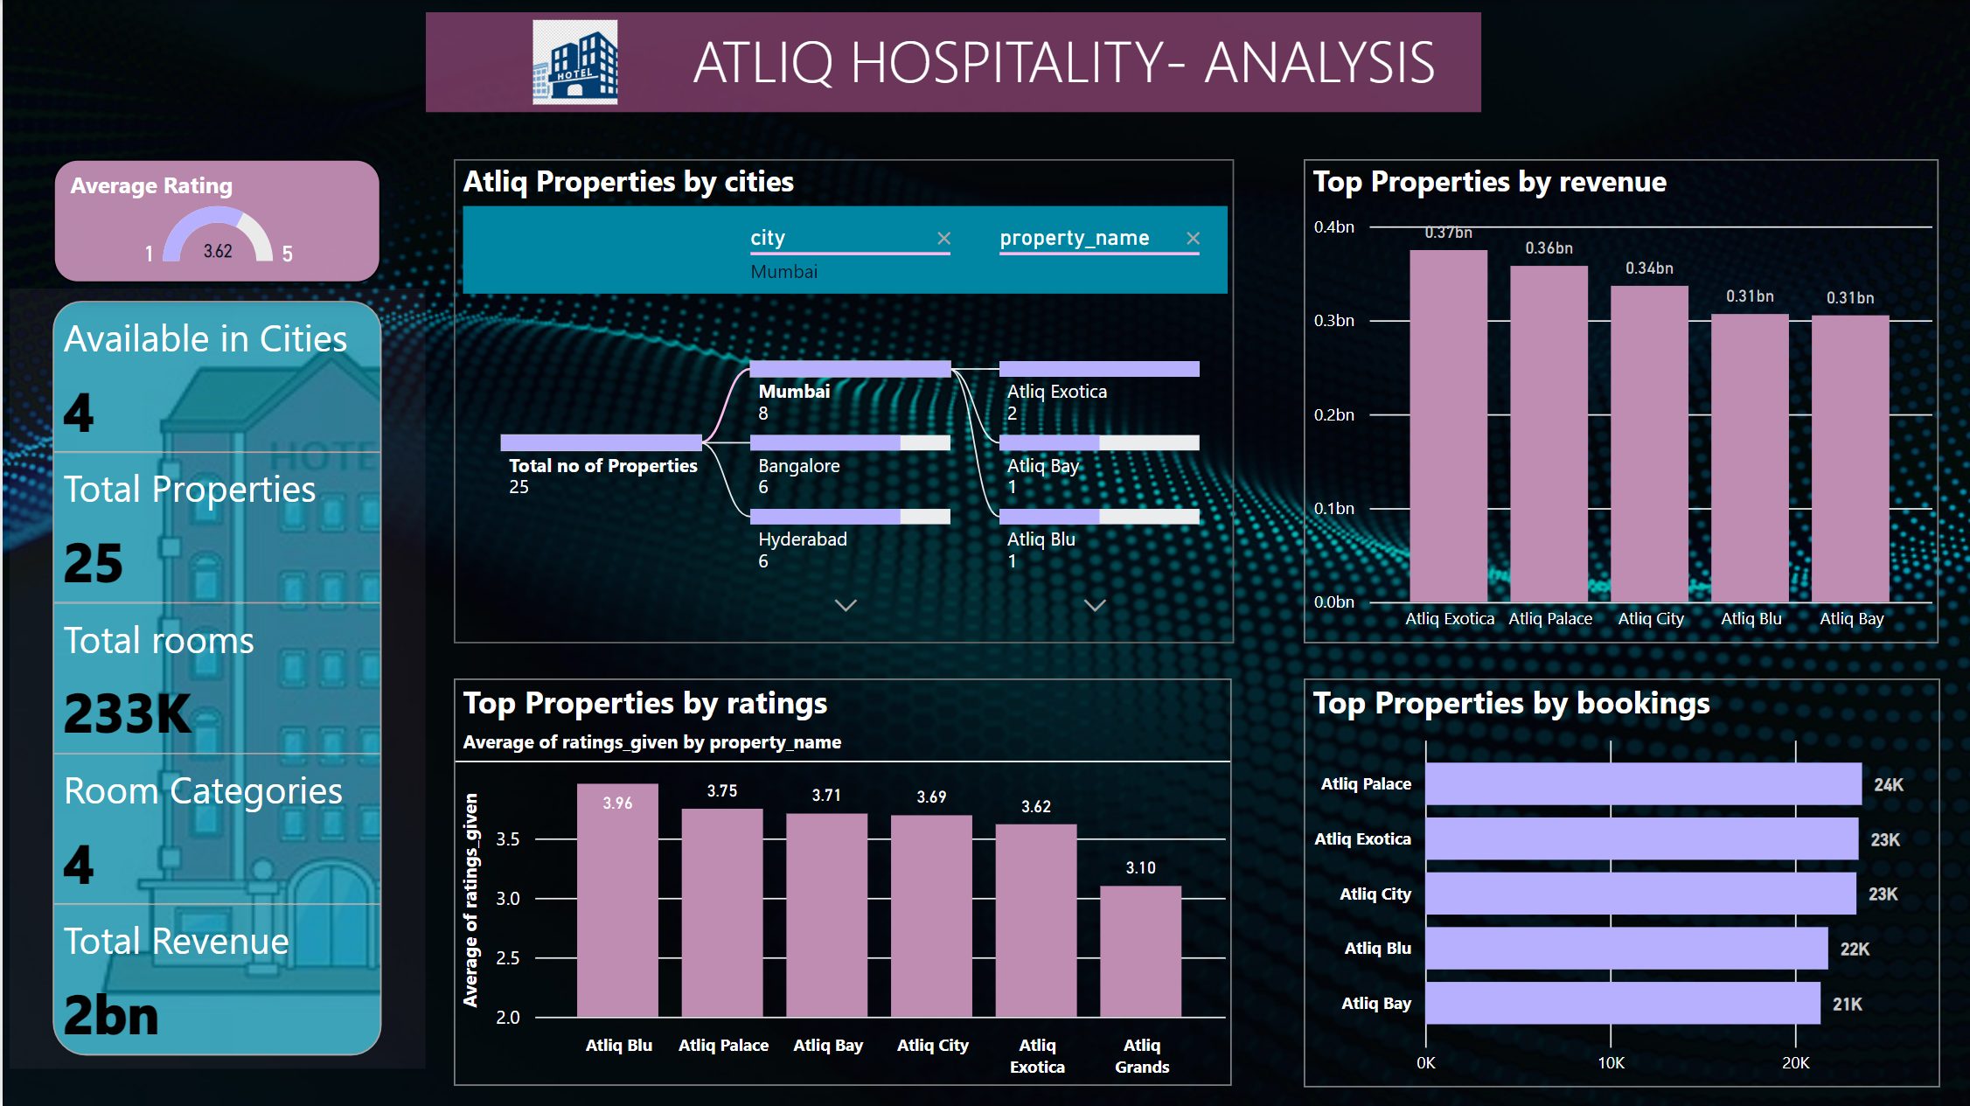
DASHBOARD

Slide 8
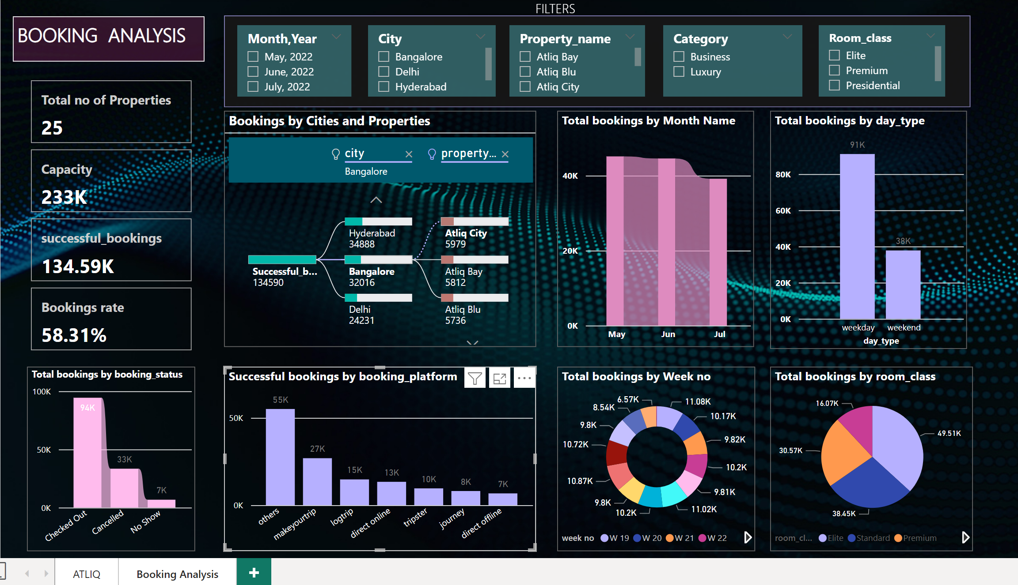

Slide 9
OBSERVATIONS
Atliq Properties are located in four cities- Delhi, Mumbai, Hyderabad and Bangalore
There are about 25 Properties in total.
Booking rate is about 58%
Highest room bookings were done in the city Mumbai
Atliq Grands records the Highest Successful bookings
Atliq Seasons records the lowest Successful bookings
Highest Bookings were done for Room category RT1-Standard
Average rating given was 3.6

Slide 10
CONCLUSION
Through data-driven decision-making, Atliq Bay and Atliq Seasons can:
Boost Revenue: Implement targeted strategies for maximizing revenue across properties and platforms.
Enhance Guest Experience: Analyze guest feedback to personalize experiences and address areas for improvement.
Optimize Operations: Allocate resources effectively based on occupancy trends and booking patterns.

Slide 11
THANK YOU

